Slide 1
NFL Yardage Predictions
By: Ethan Oliver and Aron Vekassy

Slide 2
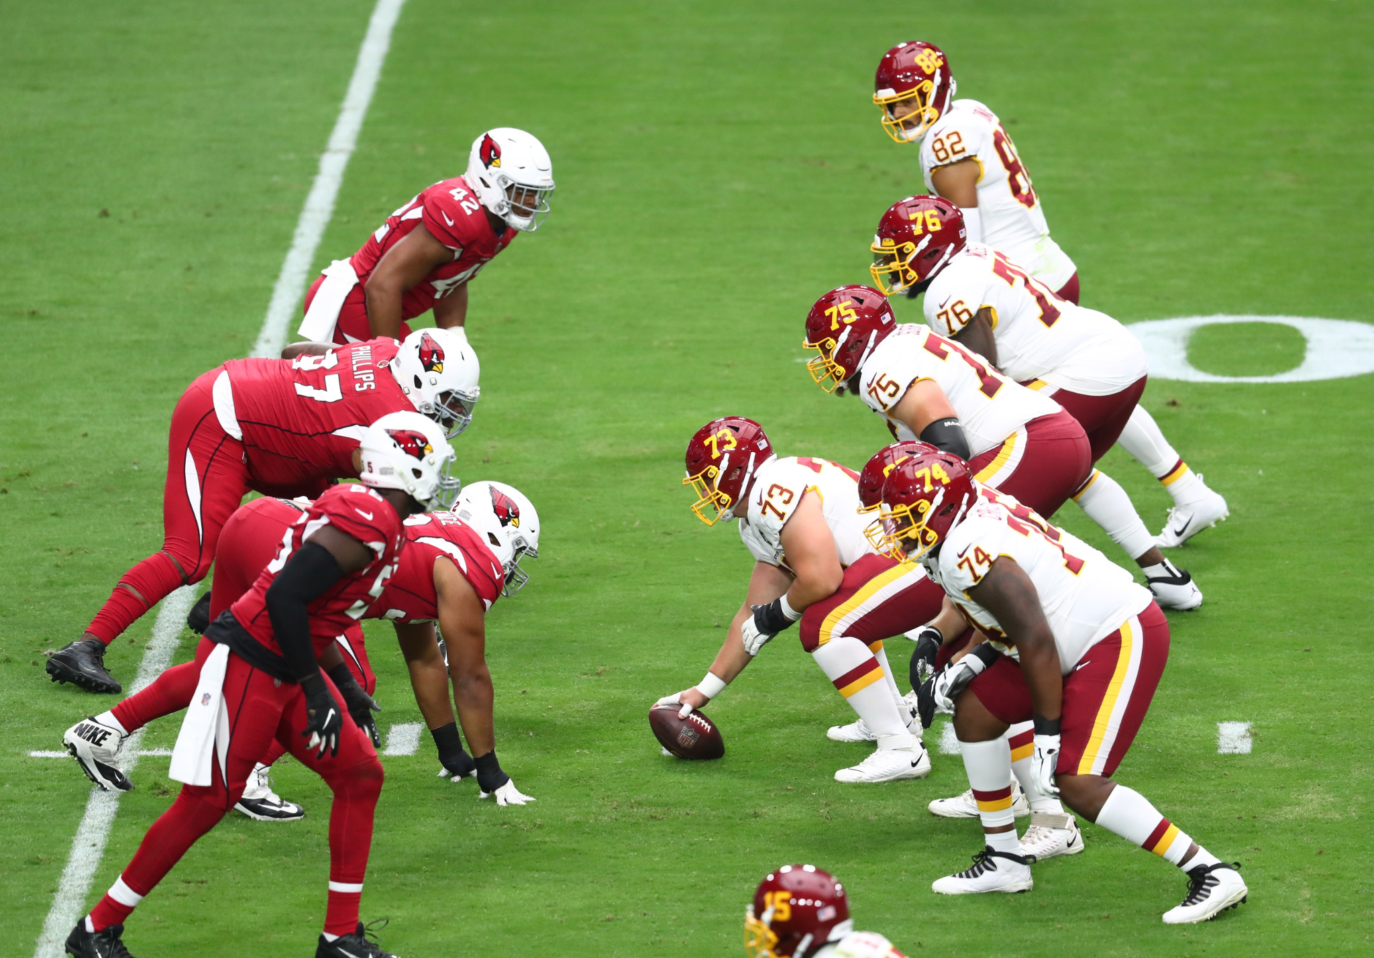
Introduction

Slide 3
Previous Works
Few published papers
Little public data
Good result would change the game

Slide 4
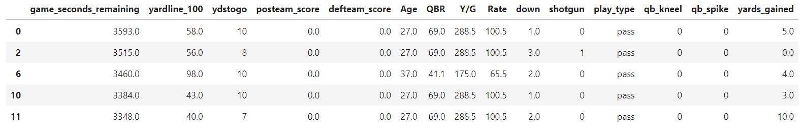
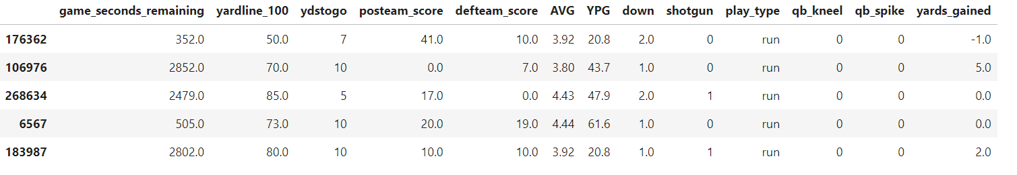
Data

Slide 5
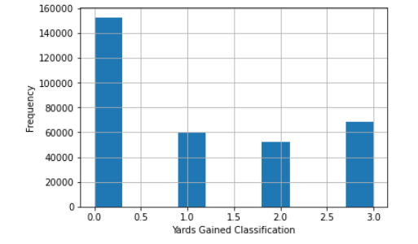
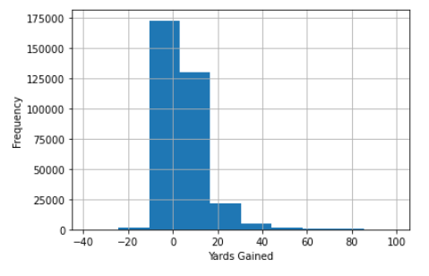
Data

Slide 6
Methods
Baseline Tests
Linear, Logistic Regression
Guess the Mean
Guess the Majority
Basic Neural Networks
One Layer, 20 Neurons, Fully Connected
Residual Connection
Complex
Multi-Layer, Fully Connected
Multiple Residual Connections

Slide 7
Evaluation
model.evaluate(X_test, Y_test)
Mean Squared Error
Categorical Cross Entropy
Accuracy
Regression Plots
Confusion Matrix

Slide 8
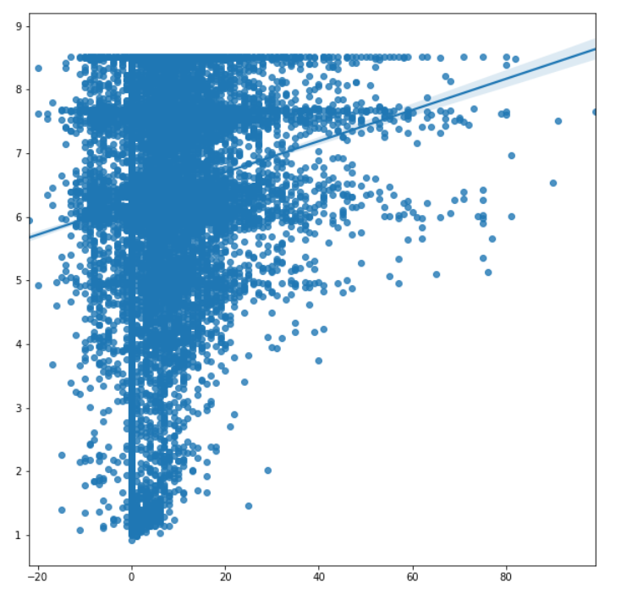
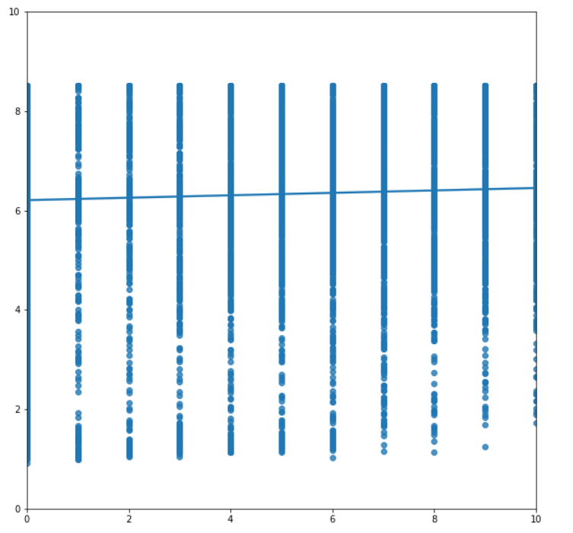
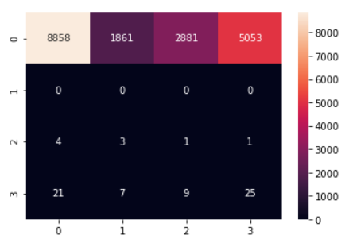
Regression Plots/Confusion Matrix

Slide 9
Final Thoughts
Very complex topic
Bad results are likely caused by the data
NFL teams have access to much more
Great learning experience

